Slide 1

INSTITUTE OF AERONAUTICAL ENGINEERING
ELECTRONICS AND COMMUNICATION ENGINEERING
LOW-COST WIRELESS SENSOR NETWORK FOR IN-FIELD OPERATION MONITORING OF AC MOTOR USING IOT
Supervisor:-
Mr. B.Brahmaiah
Assistant Professor
ECE Department
S.NO | Name | Roll No. | Branch & Section
1 | A.D.REVANTH | 20951A0439 | ECE-B
2 | S.HARI KRISHNA | 20951A0457 | ECE-C
3 | G.RAHUL CHAND | 20951A04C7 | ECE-D

Slide 2
ABSTRACT
This project focuses on developing an efficient and automated power survey system for real-time monitoring of AC motors in industrial environments.
Utilizing Wi-Fi technology for data transmission, the system incorporates sensors for voltage, current, temperature, and frequency interfaced with a microcontroller.
The microcontroller processes the sensor inputs, sending the data to the Thingspeak cloud via Wi-Fi. Users can access and view the parameters on their mobile phones.
In case of abnormalities, the system triggers alerts through a buzzer. The microcontroller is programmed in embedded 'C' language to execute these tasks seamlessly.

Slide 3
INTRODUCTION
The effectiveness and longevity of AC motors are critical factors in the fields of industrial automation and process control. It is crucial to keep an eye on these motors' performance and condition to avoid expensive downtime.
It guarantees peak performance, and prolong the life of your equipment but historically, putting in place a reliable monitoring system has meant incurring large expenses and complicated configurations .
Presenting our creative fix: an affordable wireless monitoring system made especially for AC motors. With the innovative combination of affordability and state-of-the-art technology, this system opens up motor monitoring to a broad spectrum of industries and applications.

Slide 4
PROBLEM STATEMENT
ABSTRACT
The monitoring of AC motors poses a critical challenge in industrial operations, where the lack of efficient and cost-effective solutions inhibits the ability to ensure optimal performance and prevent unexpected breakdowns. Current monitoring systems often come with prohibitive costs, making them inaccessible for a significant portion of businesses, especially smaller enterprises with limited resources. The complexity of traditional monitoring setups, involving intricate wiring and installation processes, further exacerbates the problem by demanding specialized skills and elongating deployment times.
Additionally, the scalability of existing solutions remains a concern, as many systems struggle to adapt seamlessly to different industrial contexts and motor quantities. The overarching issue is the need for a more affordable, user-friendly, and scalable monitoring system tailored specifically for AC motors, addressing these challenges and allowing businesses of all sizes to implement effective predictive maintenance strategies.

Slide 5
OBJECTIVES
The objectives of addressing the monitoring challenges associated with AC motors are multifaceted. First and foremost, the goal is to develop a cost-effective solution that significantly reduces the financial barriers hindering the widespread adoption of motor health monitoring practices. By incorporating affordable sensors and wireless communication technologies, the aim is to create a system that is accessible to businesses of varying sizes.
Scalability is paramount, as the system should seamlessly adapt to diverse industrial contexts and motor quantities, ensuring flexibility and ease of integration across different operational scales. Ultimately, the overarching objective is to empower businesses to implement proactive monitoring strategies, fostering increased operational efficiency, reduced downtime, and extended AC motor lifespan.

Slide 6
EXISTING METHODOLOGY
The current methodologies employed for monitoring AC motors face notable limitations, particularly in the absence of Internet of Things (IoT) technologies. Conventional approaches often rely on wired sensors and centralized monitoring systems, leading to increased complexity in installation due to extensive wiring requirements. These systems tend to be cost-prohibitive, making them less accessible to businesses with budget constraints, especially smaller enterprises. The lack of real-time connectivity and data accessibility further hampers the effectiveness of these methodologies, as operators may encounter challenges in promptly identifying and addressing potential issues.
Moreover, the scalability of existing solutions remains a concern, with difficulties in adapting monitoring systems to varying industrial contexts and motor quantities. In light of these shortcomings, there is a pressing need for a monitoring methodology that addresses these challenges without relying on IoT, ensuring cost-effectiveness, simplified deployment, and improved adaptability to diverse operational environments.

Slide 7
PROPOSED METHODOLOGY
This project aims at building an efficient and automatic power survey system, which is capable of monitoring the electrical parameters of AC motor, which are present in real time industrial environment.
Wi-Fi (Short for Wireless Fidelity) is a wireless technology that uses radio frequency to transmit data through the air. Wi-Fi has initial speeds of 1mbps to 2mbps. Wi-Fi transmits data in the frequency band of 2.4 GHz. It implements the concept of frequency division multiplexing technology. Range of Wi-Fi technology is 40-300 feet.

Slide 8
PROPOSED METHODOLOGY
The main controlling device of the whole system is a Microcontroller. AC motor through Voltage sensor, current sensor, temperature sensor and frequency counter are interfaced to Microcontroller. The Microcontroller gets input from all the sensors, which will be processed and transmitted into to the thingspeak cloud over WI-FI module. The parameters are displayed on the mobile phone. The system alerts through BUZZER if any abnormality is detected in the parameter values. To perform the task, Microcontroller is loaded with an intelligent program written in embedded ‘C’ language.

Slide 9
LITERATURE SURVEY
S . No | Title | Authors | Published Year | Methodology | Drawbacks
1 | Critical Survey on IOT Based Monitoring and Control of Induction Motor | Sudharani Potturi Dr. Rajashekar P. Mandi | 2022 | Implementation of IOT (Internet Of Things) for monitoring and control of Induction Motor for various applications such as Electric Vehicles , Industries, Agriculture field etc | Limited Experimental Validation Lack of mature design tools Outdated References Incomplete Comparison or Evaluation
2 | IoT-Based Wireless Induction Motor Monitoring | Mehmet Şen, Basri Kul | 2017 | The study likely involves the development and implementation of a wireless IoT system for monitoring induction motors. The methodology may include sensor integration, data transmission, and possibly cloud-based analysis. | Lack of detailed experimental validation. Limited comparison with existing solutions. Potential issues related to scalability or practical implementation.

Slide 10
3 | IoT-Based Traction Motor Drive Condition Monitoring in Electric Vehicles: Part 1 | Jakkrit Kunthong, Tirasak Sapaklom, Mongkol Konghirun, Cherdchai Prapanavarat, Piyasawat Navaratana Na Ayudhya, Ekkachai Mujjalinvimut, Sampast Boonjeed | 2017 | The study likely involves developing an IoT-based system for monitoring the condition of traction motors. The methodology include sensor integration, data transmission, and possibly cloud-based or centralized monitoring. | Limited validation with real-world electric vehicle conditions. Lack of a comprehensive comparison with alternative monitoring systems. Potential challenges related to scalability or practical implementation.
4 | Real-Time Condition Monitoring System for Industrial Motors | S. S. Goundar, M. R. Pillai, K. A. Mamun, F. R. Islam, R. Deo | 2015 | the study likely involves the development of a system for monitoring the condition of industrial motors in real-time. The methodology may include sensor integration, data acquisition, and possibly the use of advanced algorithms for real-time analysis. | Limited validation with a diverse range of industrial motor conditions. Lack of detailed information on the system's scalability and adaptability. Potential challenges related to practical implementation in industrial settings.
5 | IoT Platform for Condition Monitoring of Industrial Motors | A. Ajitha, D. Swathi, J. Laxmi Prasanna, D. Shyamala | 2017 | the study likely involves the development of an IoT platform for monitoring the condition of industrial motors. The methodology may include sensor integration, communication protocols, and possibly cloud-based data analysis. | Limited validation with diverse industrial motor conditions. Lack of a comprehensive comparison with alternative monitoring platforms. Potential challenges related to scalability and real-world implementation.
LITERATURE SURVEY

Slide 11
6 | Submersible Pump Control for Agriculture Irrigation Using IoT Technique | S. Vaseela, K. Rajasukumar, D. Aravinth Kumar, R. Gowtham, R. Geethanjali | 2017 | the study likely involves developing a system for controlling submersible pumps in agriculture irrigation using IoT techniques. The methodology may include sensor integration, communication protocols, and possibly cloud-based or centralized control. | Limited validation with diverse agricultural conditions. Lack of a comprehensive comparison with alternative irrigation control systems. Potential challenges related to scalability and real-world implementation in agricultural settings.
7 | Design of IoT-Based Intelligent AC Drive System Using Space Vector Algorithm | Amey C. Thombre, Saumil Shah, Ameya S. Thombre, Govind T. Haldankar, Prashant V. Kasambe | 2017 | the study likely involves designing an intelligent AC drive system using the Space Vector Algorithm with IoT integration. The methodology may include algorithm implementation, sensor integration, and communication protocols for IoT connectivity. | Limited validation with diverse AC drive system conditions. Lack of a comprehensive comparison with alternative intelligent drive systems. Potential challenges related to scalability and real-world implementation in various applications.
8 | Motor Control Used To Be Boring | Alexander Tessarolo | 2016 | the research likely discusses advancements or innovations in motor control. The methodology might involve reviewing existing motor control technologies, exploring novel approaches, or presenting theoretical advancements. | Lack of practical implementation details or experimental validation. Limited focus on specific applications or use cases for the discussed motor control advancements. Potential challenges related to scalability or real-world integration.
-

Slide 12
9 | Online Parameter Monitoring of Induction Motor Using Wireless Network | Geetha P, V. Saravanan | 2012 | the research likely involves the development and implementation of a system for monitoring induction motor parameters using a wireless network. The methodology may include sensor integration, wireless communication protocols, and possibly cloud-based or centralized data analysis. | Limited validation with diverse induction motor conditions. Lack of a comprehensive comparison with alternative monitoring systems. Potential challenges related to scalability and real-world implementation in industrial settings.
10 | IoT Based Health Monitoring System for Electrical Motors | Naveed Khan, Faizan Rafiq, Faisal Abedin, Farid Ullah Khan | 2019 | The research involves designing an IoT-based system for health monitoring of electrical motors. Parameters such as vibration, current, and temperature are measured using sensors like accelerometer, current sensor, and thermocouple.Signals from these sensors are transmitted to a web server through a Wi-Fi module, making them accessible globally via the internet. | Limited discussion on the specific fault identification algorithms or methods employed. Scalability challenges or limitations in handling diverse industrial motor conditions. Validation of the system's effectiveness across various motor types and operational scenarios might not be detailed.
11 | IoT Application for Fault Diagnosis and Prediction in Elevators | Omid Salim, E. A. | 2017 | The methodology likely includes sensor integration within elevators to monitor various parameters relevant to the system's health. IoT technologies are used to transmit data from sensors to a central system for analysis. The focus is on leveraging IoT for proactive fault diagnosis and prediction, enhancing maintenance activities. | Limited discussion on the specific sensors used and their placement within the elevator system. Scalability challenges or limitations in handling diverse elevator types and operational scenarios. Validation of the system's effectiveness across various elevator models and fault scenarios might not be detailed.
-

Slide 13
FEATURES
The major features of this project are:
Automatic parameter monitoring of AC motor.
Wireless data reception and display system.
Alerting in case abnormal parameter values.
Wireless data monitoring using thing speak technology.

Slide 14
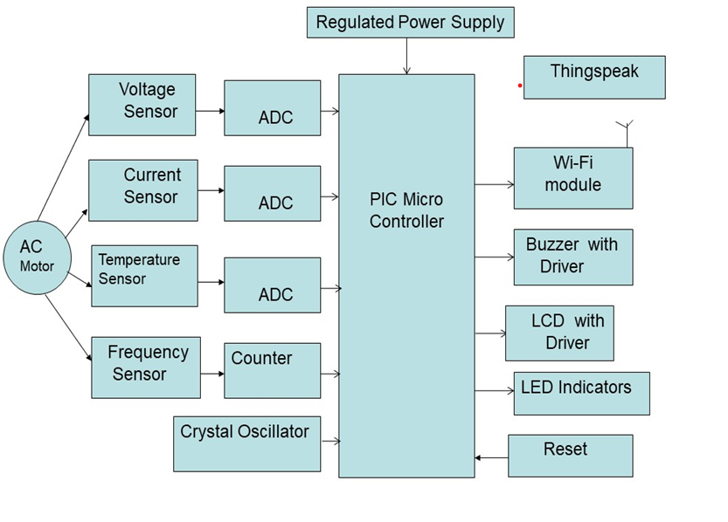
BLOCK DIAGRAM

Slide 15
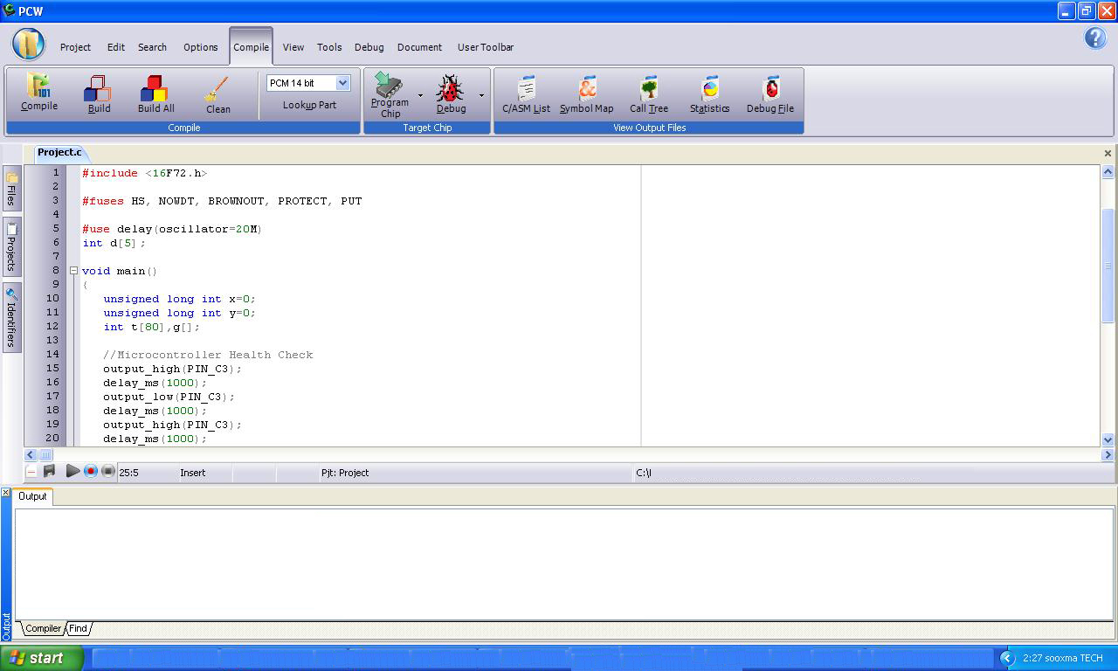
COMPILING FILE USING PIC C COMPILER

Slide 16
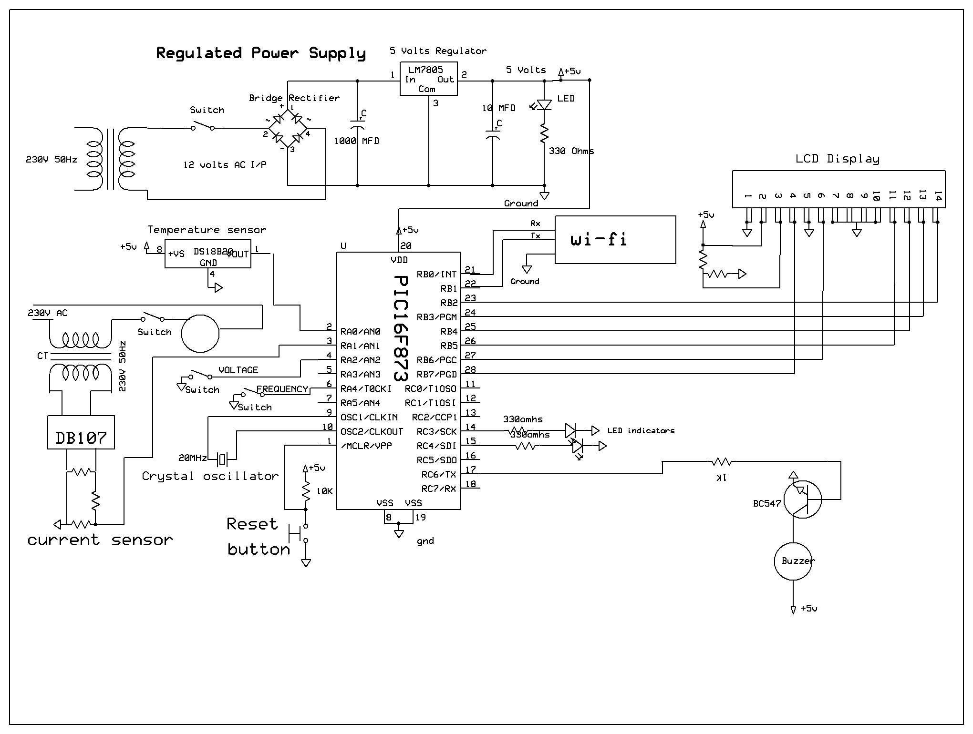
Schematic diagram of wireless sensor network in field operation monitoring of AC motor using IOT

Slide 17
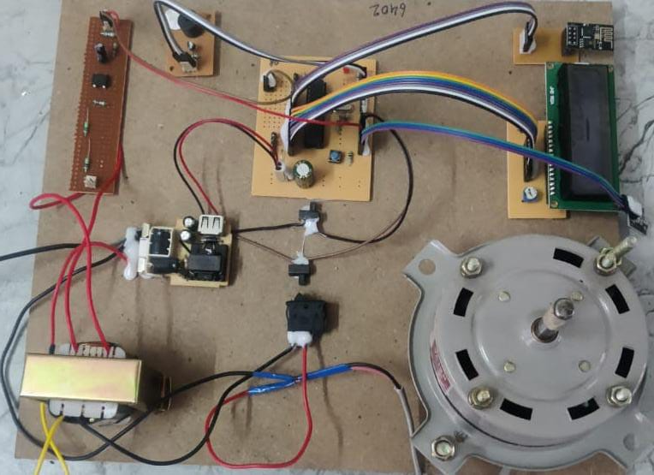
PROTOTYPE MODEL

Slide 18
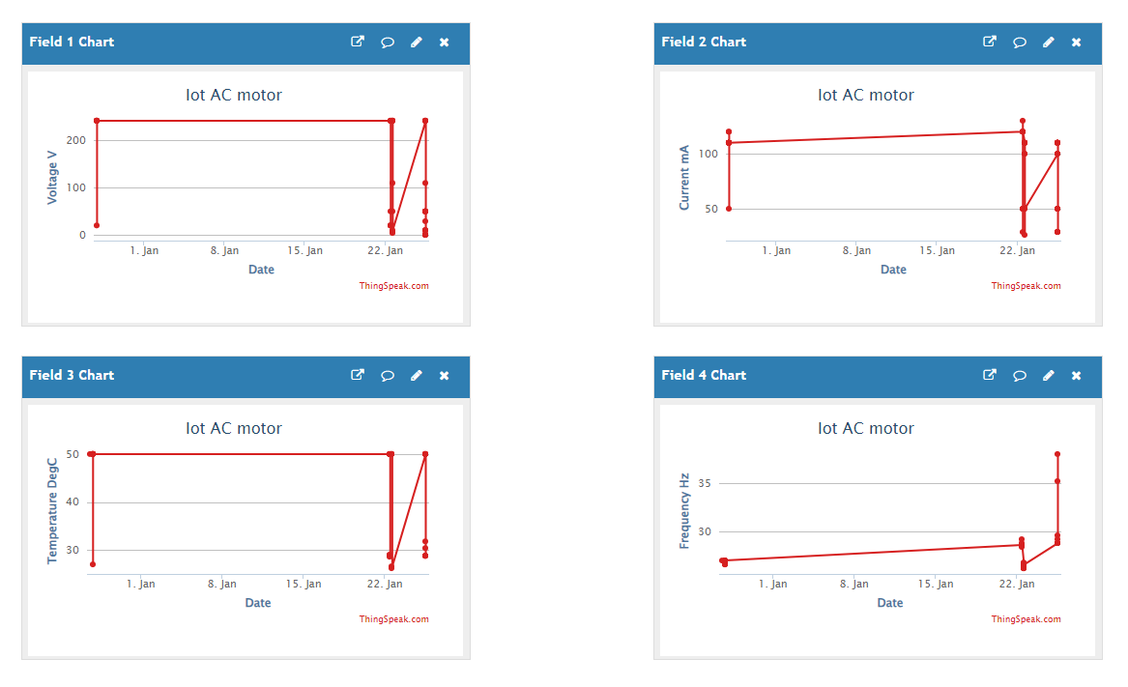
RESULTS

Slide 19
CONCLUSION
The main controlling device of the whole system is a Microcontroller. AC motor through Voltage sensor, current sensor, temperature sensor and frequency counter are interfaced to Microcontroller. The Microcontroller gets input from all the sensors, which will be processed and transmitted into to the thingspeak cloud over WI-FI module. The parameters are displayed on the mobile phone. The system alerts through BUZZER, if any abnormality is detected in the parameter values. To perform the task, Microcontroller is loaded with an intelligent program written in embedded ‘C’ language. The Microcontroller is programmed using Embedded C language.
Integrating features of all the hardware components used have been developed in it. Presence of every module has been reasoned out and placed carefully, thus contributing to the best working of the unit. Secondly, using highly advanced IC’s with the help of growing technology, the project has been successfully implemented.

Slide 20


